Slide 1
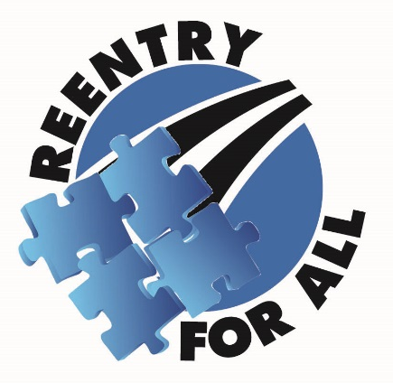
Supporting Offender Reentry
Through Tablet Technology
Montgomery County Department of Correction and Rehabilitation
Reentry Services
RSAT-TTA Webinar December 21, 2016

Slide 2
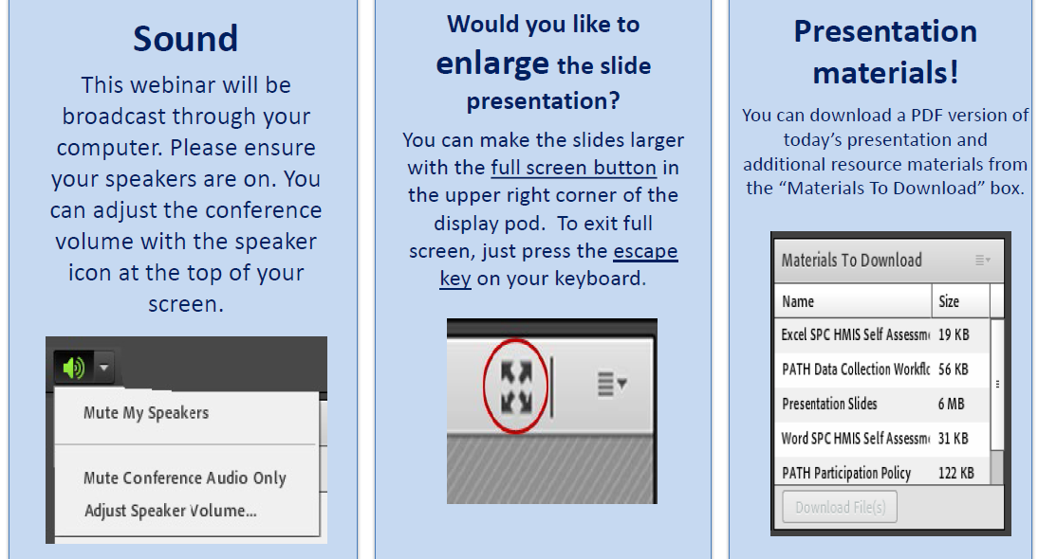
Housekeeping: Functions

Slide 3
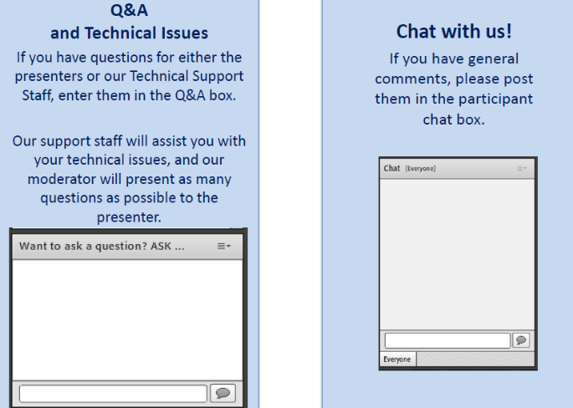
Housekeeping: Communication

Slide 4

Supporting Offender Reentry
Through Tablet Technology
Kendra Jochum, LCSW-C Melissa George, LCSW-C
Reentry Services Manager Reentry Social Worker
MCDOCR Detention Services Division
DOCR Website: www.montgomerycountymd.gov/cor
Like Us on Facebook! Facebook/ReentryForAll

Slide 5
Presentation Objectives
Discuss challenges of offender reentry and identify at least five evidence base service strategies.
Describe the Reentry Tablet Program and at least five benefits of using tablet technology to support offender reentry.
Detail at least five considerations for tablet implementation.
Identify at least five security features of tablet technology to meet standards within maximum security settings.

Slide 6
POLL 1: Tablet Technology Considerations
What are important considerations about tablet technology for you?
  Check the box next to your preferred answer(s)
  There is no submit button

Slide 7
POLL 2: How Are You Using
Tablet Technology
How are you using tablet technology in your facility?
  Check the box next to your preferred answer(s)
  There is no submit button

Slide 8
Reentry Considerations and Evidence Based Strategies
Risk-Need Assessment
Criminogenic Risk Factors
Static vs Dynamic Risks
Risk-Need-Responsivity
Targeted Intervention
Pretrial vs Sentenced
Length of Stay
Staff to Inmate Ratios
Program Delivery and Dosage
Jail Based vs Community Based
Proximity of Resources
Community Connections
Inmates have a wide range of individual reentry needs that present with an even broader complexity of varying length of time in custody, recidivism risks, and personal readiness for change.

Slide 9
Risk-Need-Responsivity Model (RNR)
Risk Principle
The risk principle states that the level of service should match an offender’s risk of reoffending. An agency should devote more resources to the highest-risk offenders, and those interventions should target an individual’s specific criminal risk factors. Low-risk offenders should receive minimal or no treatment.
Risk levels are determined by examining factors linked to re-offense. Those risk factors can either be static factors that cannot be changed (including age, gender, criminal history and age of first arrest) and dynamic factors that can be changed through successful interventions (including substance abuse, education deficiencies, antisocial personality patterns and pro-criminal attitudes).
Need Principle
The need principle states that corrections agencies should assess an offender’s dynamic criminal risk factors, often called criminogenic needs, and focus treatment on those.
Responsivity Principle
The responsivity principle essentially entails providing the right treatment at the right level. An agency can maximize an offender’s ability to learn from a rehabilitative intervention by providing cognitive behavioral treatment and support and matching intervention to an offender’s learning style, what will motivate an offender to change, abilities and strengths.
http://offenderchange.org/programs/risk-need-responsivity-model

Slide 10
APIC Model: Implications for Successful Transition and Reentry
Behavioral health, corrections, and community agencies should partner on state and local levels to develop cross-system approaches based on the principles of APIC
APIC stands for:
  Assess the individual’s clinical and social needs, and public safety risks;
  Plan for the treatment and services required to address the individual’s needs (while in custody and upon reentry);
  Identify required community and correctional programs responsible for post-release services; and
  Coordinate the transition plan to ensure implementation and avoid gaps in care with community-based services.
  GAINS Center: Guidelines for the Successful Transition of People with Behavioral Health Disorders from Jail and Prisonhsa.gov/topical_resources/reentry.asp

Slide 11

Prioritizing Reentry Needs and Strategies
What Does Reentry Look Like?
Risks and Needs
Length of Stay
Individualized, Targeted Interventions
_______________________________
Day of Release
First Week
First Month
First Year

Slide 12
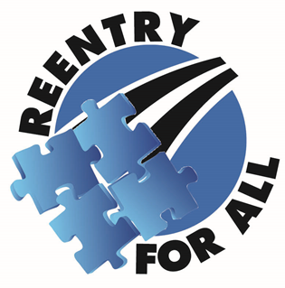
MCDOCR Reentry Services
"Reentry For All" is our motto reflecting the spirit of our work is to provide comprehensive reentry services and support to returning citizens as individuals, as members of their families, and as members of our community.
"All" represents everyone in our population we want to provide information and services to, all the programs and partners coordinated together, as well as "all" the individuals returning, their families, and the communities.

Slide 13
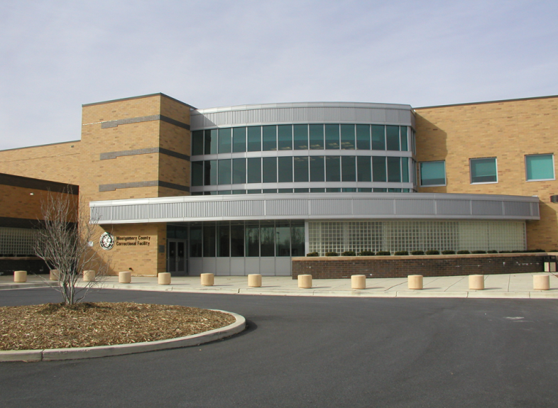

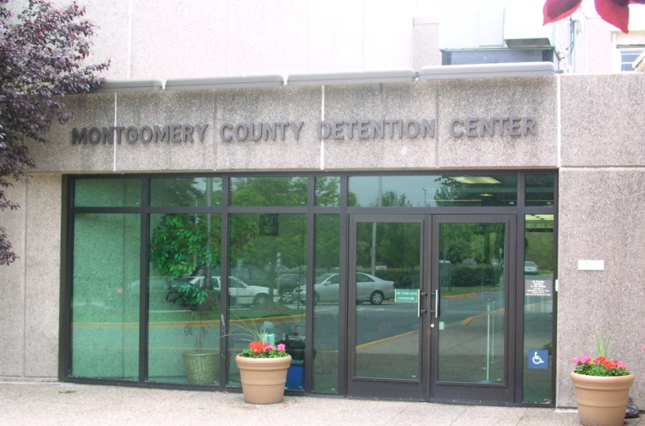
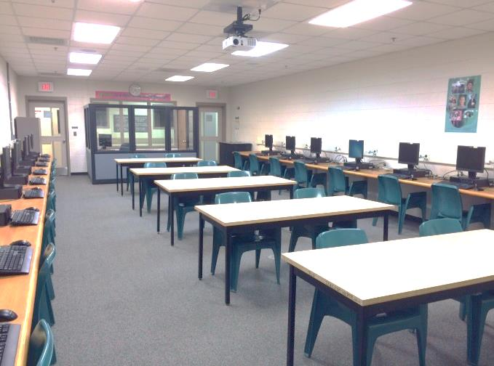
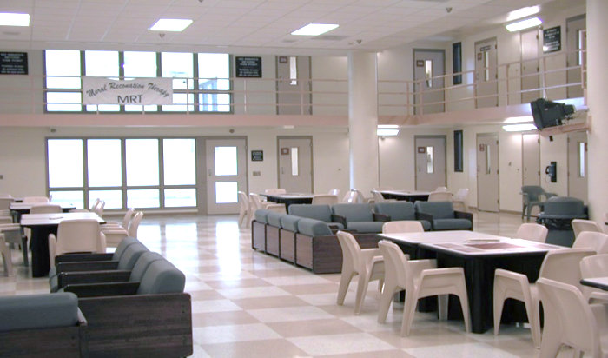
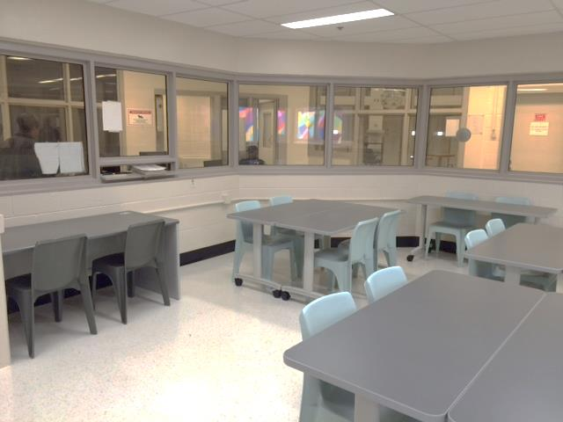
Montgomery County Correctional Facility
Montgomery County Detention Center
Jail Based Reentry Services

Slide 14
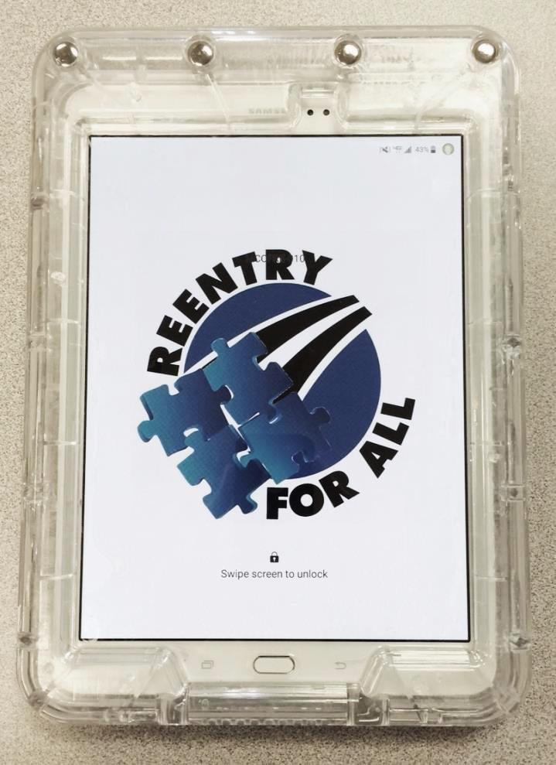
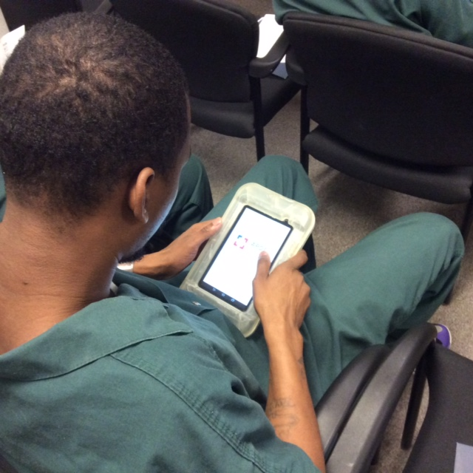
Montgomery County DOCR
Reentry Tablet Program
Using Tablet Technology in Supporting Programs, Services and Reentry Transition within MCCF and MCDC

Slide 15
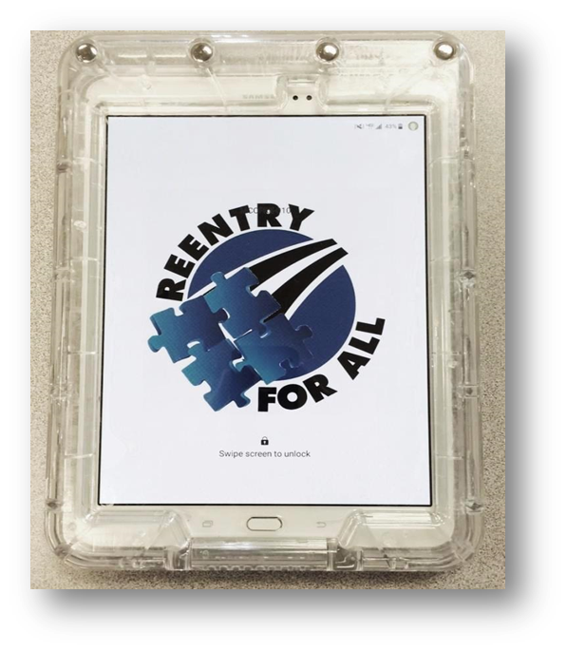
Supporting Reentry For All
Through Tablet Technology
Individual
Staff
Facility
Family
Community

Slide 16
Reentry Tablet Program
Tablet technology has already entered into correctional education classrooms, and this program supports a new foundation of contemporary corrections.
  Bridges technology with reentry services and inmate programs to demonstrate successful approaches throughout a maximum security facility.
Reentry Tablets were initially grant funded through the MD Governor's Office of Crime Control and Prevention with no cost to local tax payer dollars.
  Continued through annual Inmate Council budget.
As a staff tool these tablets extend the service reach of reentry staff by providing important information, resources, and skill development modules directly to individual inmates.
  This increased access to services and information is a critical benefit as limited reentry staff resources cannot reach the full scope of needs and complexities of the entire custodial population.

Slide 17
Service Benefits of Tablet Technology
Additional Tool is a Significant Advantage for Staff to Incorporate as Part of Larger Service Strategy
Increases Client Access and Dosage to Information, Program Material, Skill Development, and Resources
Supports Ownership of Personal Reentry Needs
Flexible and Independent Study
Individualized Menu of Information and Materials
Interactive Features to Enhance Exposure and Learning Experiences

Slide 18
System Benefits of Tablet Technology
Improve safety for Corrections Staff and Inmates
Useable in All Security Settings
Deliver Significant Cost Savings to Facility Administrators and Taxpayers
Cost Effective Services Without High Costs to Users
Improve Outcomes for Inmates via Access to Programs and Support Systems

Slide 19
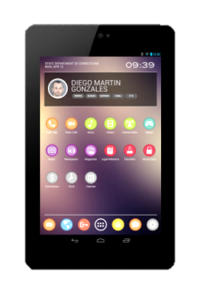
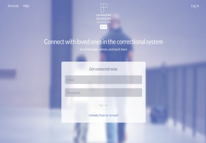
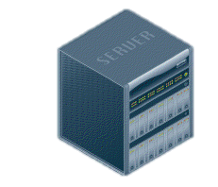
APDS = Tablets + Platform + Network
SECURE ANDROID TABLETS for INMATES
APDS tablets provide inmates with secure, monitored access to digital education, rehabilitation, job training and job placement resources.
PLATFORM FOR PROGRAMS
The APDS platform allows for the distribution of partner programs, and hosts a range of tools and services to support correctional programs.
NETWORK SECURITY
APDS offers a private network that governs all functions of inmate tablets. A white hat hacking firm recently declared the APDS network to have “no vulnerabilities.”

Slide 20






The Platform Features
Corrections-Specific Tools and Services
      National Corrections Library
      Secure Content Locker
      Connected Corrections
      APDS Learning Management System
      APDS Virtual Classroom
      APDS Reentry Site

Slide 21
Tablet Security
American Prison Data Systems (APDS) hosts our Reentry Tablets and provides the highest security standards to ensure this technology is appropriately and safely used within the facility.
Monitored 24 hours a day
Both APDS and DOCR staff have direct control
No open access to the outside community or internet
Every function and setting of the tablet is deliberate
Hardware case and tablet are physically secure

Slide 22
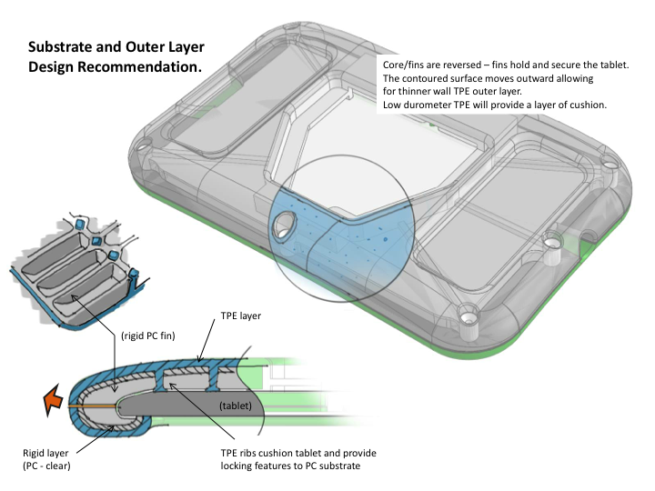
Physical Safety

Slide 23
Tablet Implementation and Logistics
Facility Preparations
  Culture Change
  Roll Call Presentations, Officer Feedback
  Staff Training
  Formal Procedures and Related Forms
Tablet Logistics
  Charging Station (s)
  Condition and Control Log
  Assignment Approval Forms
  Staff Distribution
  Tablet Assignments, Inmate Tablet Agreements
  Tablet Orientation and Tutorials for Users

Slide 24
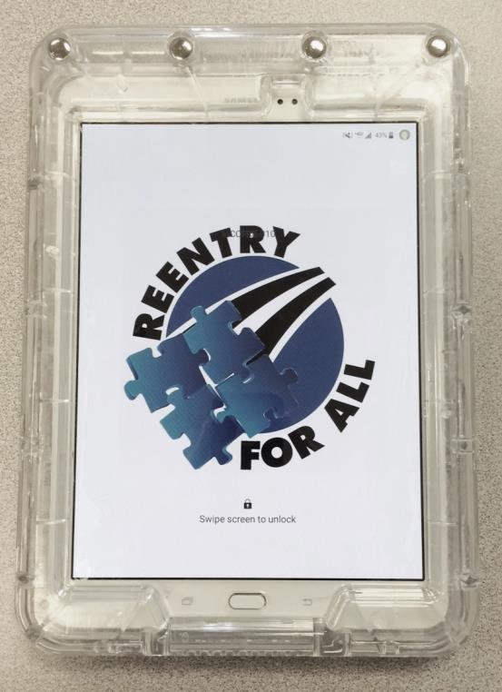
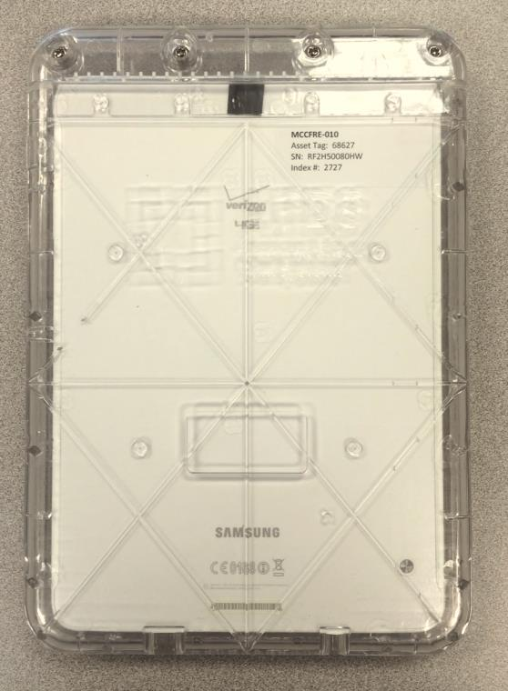
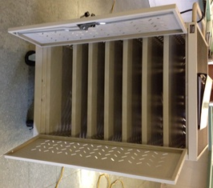
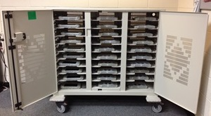
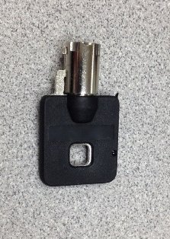

Slide 25
Reentry Tablet Content and Features
CONTENT
Carey Guide Tools - Exercises to Help You Think About Your Feelings, Choices, and Actions
eBooks - Self Help Topics
Employment and Job Readiness - Information and Resources
Family, Children, and Parenting - Information and Resources
GCFLearnFree.Org Tutorials about Computers, Internet, Email, Job Readiness, Financial Literacy and More…
MDCSL (Maryland’s Community Services Locator) Searchable Listing of Helpful Resources and Programs
MCCF/MCDC Facility Information
MCCF Programs, Groups, and Workshops
MVA Practice Driver’s License Exam
National Corrections Library – Many Fiction and Non-Fiction Titles Available for You to Enjoy Reading
PRRS Information - Pre Release Center (PRC)
Reentry Mythbusters – Provide Answers to Common Questions and Rumors
Reentry Services Information – Important Information on Available Reentry Services at MCCF
Resource Information – Listing of Important Community Programs and Services Available
Roots of Success – Credential Certificate Program for Green Job Technology
Tablet 101 Tutorials
Thinking For A Change – Curriculum Program about Thoughts, Feelings, and Choices
Workbooks- Digital Workbooks on Anger Management, Changing Behavior, and other Personal Development Topics
FEATURES
Content in Word, Power Point, PDF, MP3 Audio, MP4 Video Formats
Dictionary/Calculator
Secure Messaging with Reentry Staff
Virtual Classroom

Slide 26
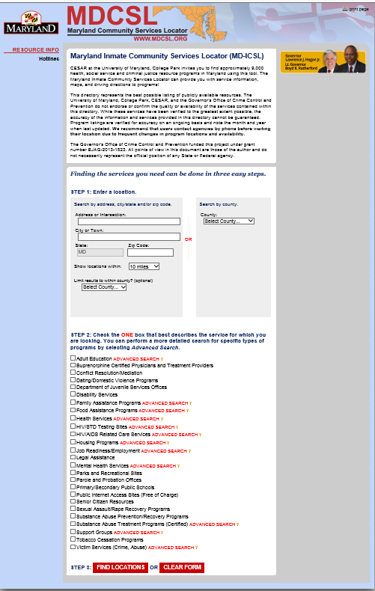
Maryland Inmate Community Services Locator
Reentry Tablet Content
Inmate users can access ICSL from Reentry Tablets
Same function as ICSL on computer
Expands inmate access to service information
Inmates use without staff resources
Direct inmate engagement and supports ownership of personal reentry needs

Slide 27


















APDS Educational, Vocational, and Rehabilitation Partners

Slide 28
Reentry Client Example #1
L.T.: 33 year old male, father of one 2 year old boy.
Enjoyed the LMS-TED. Enjoyed learning about the science, and parenting information. Spoke in detail about what he had learned about the effect of alcohol consumption during pregnancy. He said, “the only thing bad about the Tablet is that I am lost without it on the weekends!”.

Slide 29
Reentry Client Example #2
T.A.: He is 19-year-old male. He wants to get a learner’s permit and has never had a driver’s license. He is a visual learner and learns well by doing.
He took the MVA driving test and found it very helpful to motivate him in getting his learner’s permit. The first time he took the MVA driving test, he got a high score and it boost his self-esteem and self-confidence. His demeanor changed from the initial’s sadness and hopelessness to a more hopeful tone and future-orientated and goal-oriented thinking pattern. He was given a Maryland Driving Manual to complete self-study.

Slide 30
Reentry Client Example #3
G.A.: He is a 20-year-old male. His long-term goal is to study computer science and he likes Math.
He says he uses Khan Academy Tutorial to remind himself on how to do math.

Slide 31
Reentry Client Feedback
MVA driving test is a very helpful tool.
Content Locker Resources are helpful to learning more about how to establish credit, criminal background and employment, interviewing skills, and gain information on how to obtain Driver’s License/ ID.
TED talks highly motivating.
Tablets help get reentry planning started and finished.
Connected Corrections is a good tool to engage the younger inmates in short conversation and quick check-up on their progress. Helps save time to share information.

Slide 32
Developing Tablet Innovations
Interactive, Individualized Reentry Focused Content
Family Connections
Bridging With Community Providers
Transition to Supervised Parole and Probation

Slide 33
Offender Reentry…
Is there an App for that?
YES!

Slide 34
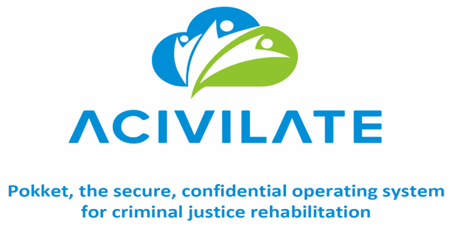

Upcoming Pilot Programs with MCDOCR Reentry Tablets
Where FaceTime Meets Family Time

Slide 35









Multiple Issues – No Single Solution
Games
Music
Video
Drawing
Messaging
Pictures
Homework
Books

Slide 36

Finding Connectivity and Adding Activity
To Bridge the Distance
Current Solutions are fractured and limited.
Competitors offer piece-meal solutions and limited offerings.
Options should be a diverse as children and their imaginations.
Kids want to play and spend time with those they love.
Skype & FaceTime can’t keep a young child’s attention – and kids need activity more than talk.
Too many missed moments lead to real impacts on learning, socialization and family time.
Kids do not receive the educational support they need from tech.
Ed tech focuses on teachers and parents – not parents and young kids.
Children with limited support are missing learning opportunities.

Slide 37

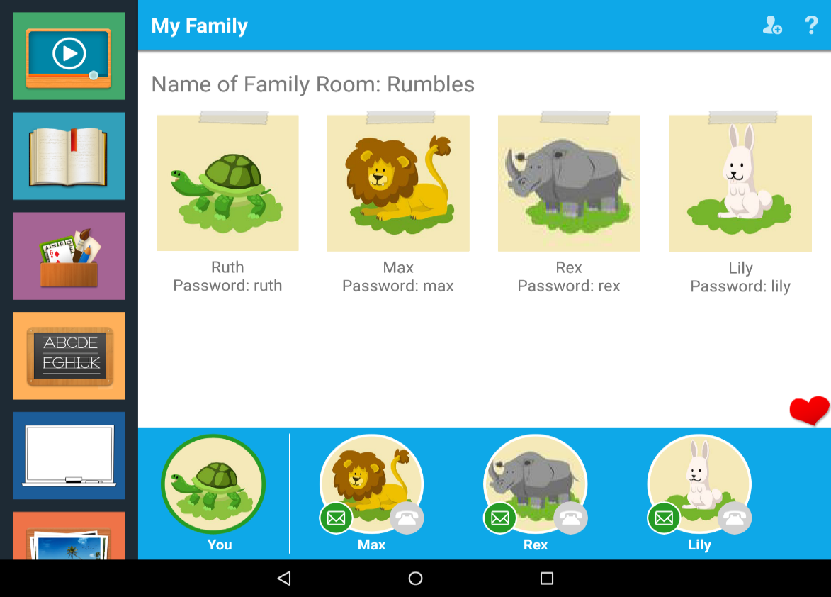
The App That Changes How Families Connect
Immersive Experience: Autonomy for the child & Control for the parent
One Stop Shop: Read, Watch, Play, Draw, Listen and Learn – all on one app.

Slide 38

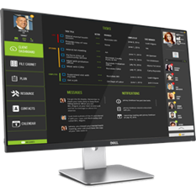
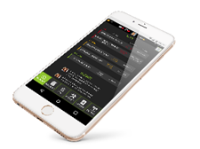

Slide 39



Expanding Reentry Tablets Into Community
MCDOCR, DPSCS, APDS and Acivilate are creating a technology based reentry process while inmates are incarcerated and that will continue post-release using Acivilate’s POKKET.
POKKET is designed to allow reentry case managers and inmates, and probationers and supervision agents, to work together electronically with community service providers to facilitate seamless reentry, and holds the probationer accountable for their participation.
  Inmates work with reentry case managers to develop, execute and track a reentry plan, including programming delivered inside the facility.
  Using tablet technology to provide reentry services within secure facility setting
  Creating and executing a referral to a service provider in the community
  Creating reentry plan entries
  Sharing documents across providers
APDS combined with POKKET borrows from the procedural justice model to create stronger relationships with probationers while also tracking compliance and functions as an early warning system to enable early interventions, avoiding failure, and supports a data-driven allocation of agent time.

Slide 40
POKKET
Application For Tablets and Smartphones
POKKET is a secure, mobile collaboration platform that overcomes privacy barriers enabling courts, correctional supervision, and service providers to coordinate rehabilitation.
Enabling greater fidelity to evidence-based practices, POKKET improves outcomes while achieving cost savings.
POKKET puts the participant in the middle of their rehabilitation so they can demonstrate accountability and success.
POKKET quickly and legally resolves information-sharing challenges in reentry planning for prisons and jails, compliance and plan execution for Probation and Parole, and in ensuring participation in programming for problem-solving courts.

Slide 41

POKKET Features
PLAN
Configure program model, then personalize per user – individualized treatment planning
Share intake and needs assessment
Affords additional needs assessment in app
Create and track goals, objectives, tasks
Track individual achievements and success
RESOURCES
Map of matched community providers
Pre-screened referrals with a positive handoff of the individual
CALENDAR
Schedule appointments with reminders and notifications
FILE CABINET
Upload information & documents & share across boundaries for better context and continuity of care
Manage Release of Information / Informed Consent
Maintain contact for outcomes reporting
PROGRAM SUPPORT
Fidelity to the evidence-based program model
Policy, budget & grant planning and reporting

Slide 42
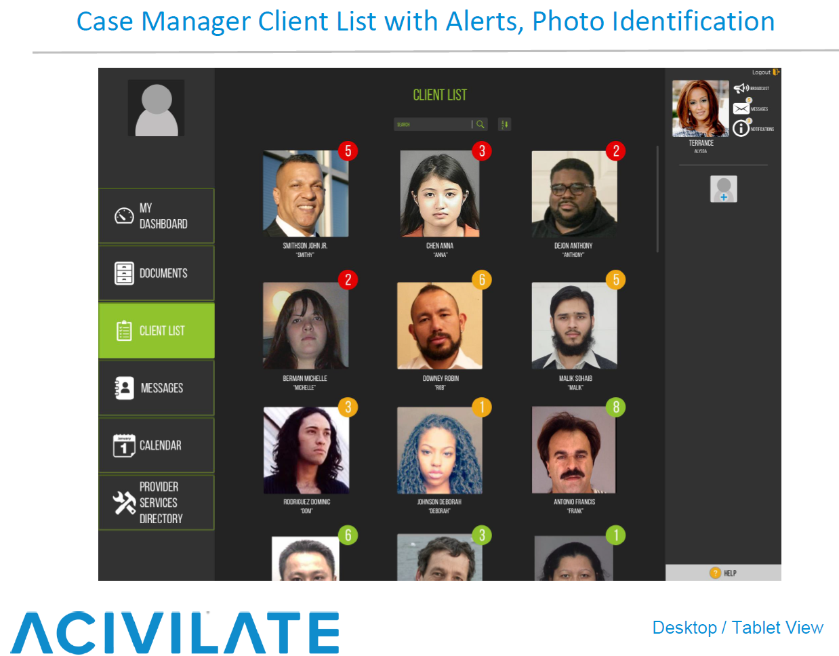

Slide 43
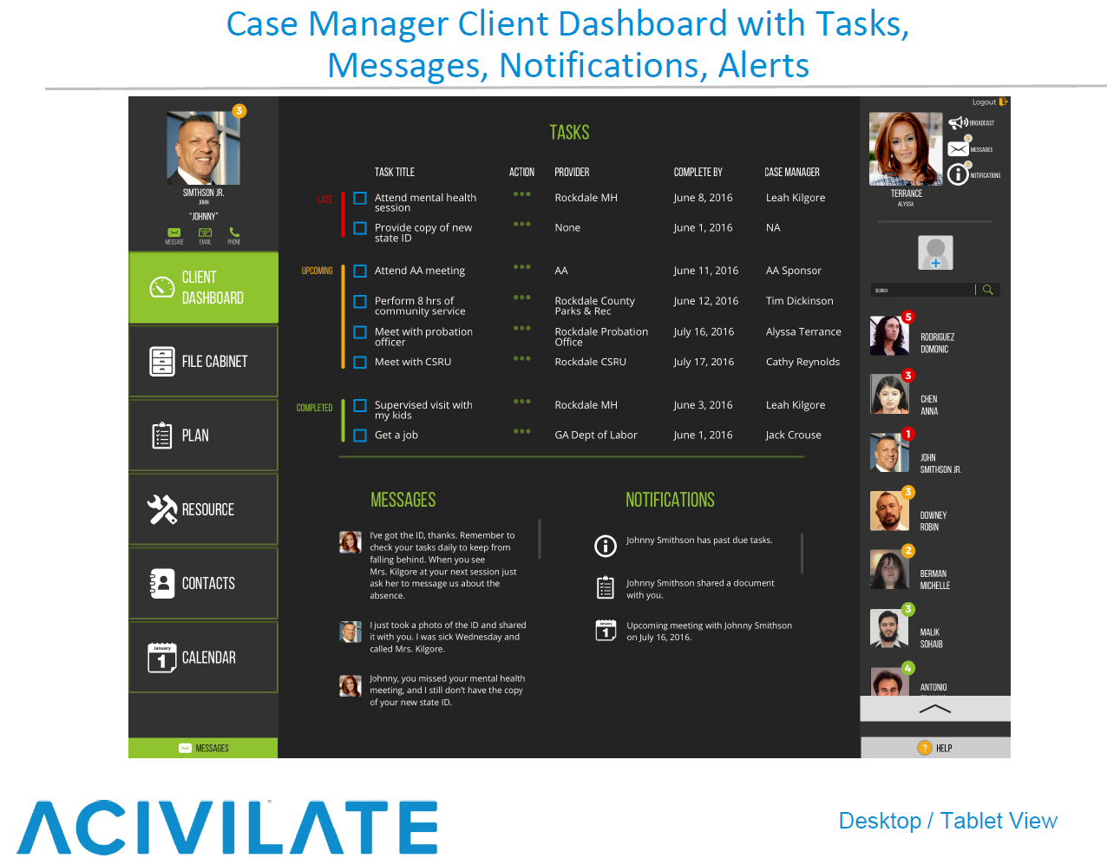

Slide 44
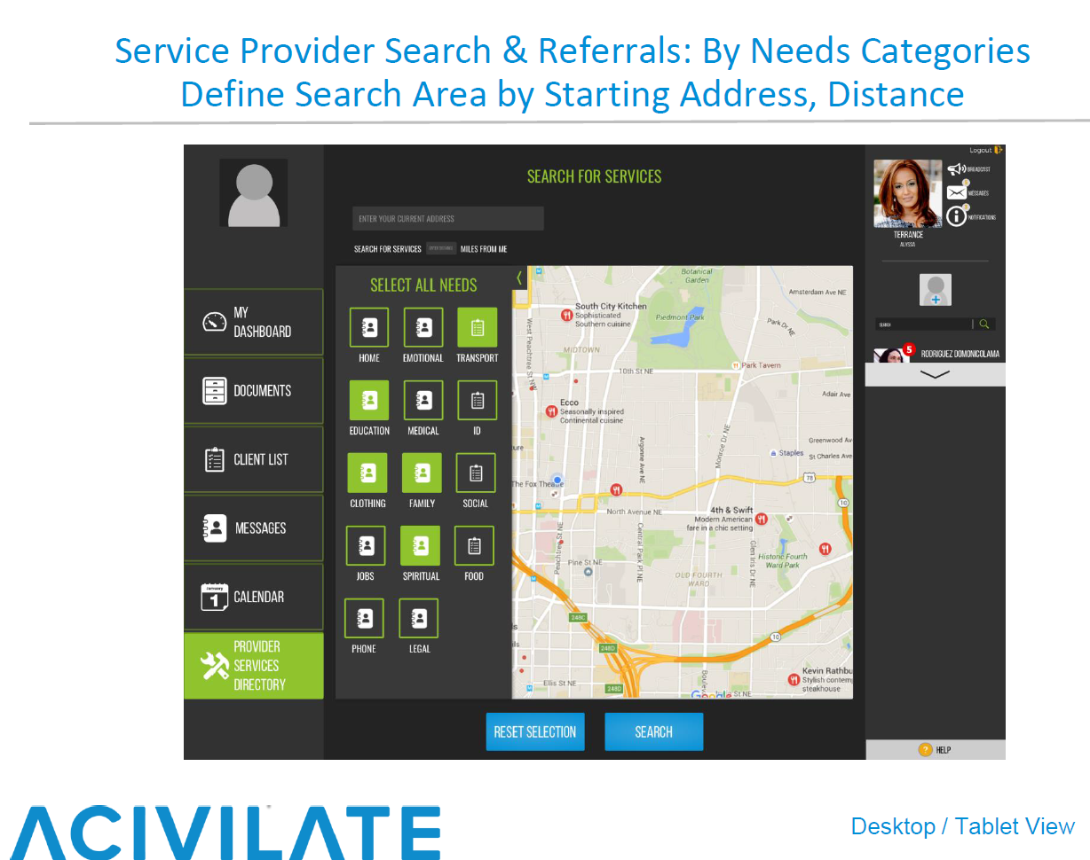

Slide 45
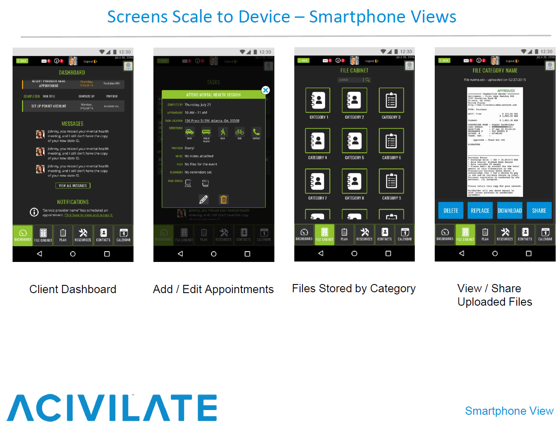

Slide 46
Questions? Comments …
Please share any questions or comments!
What elements of tablet technology would you find most appropriate and beneficial for your setting?
What are some remaining challenges you anticipate to implement tablet technology?
Is there anything about tablet technology that you were surprised to learn more about?
What are other ways you can envision tablet technology increasing efficiency and services within your setting?

Slide 47
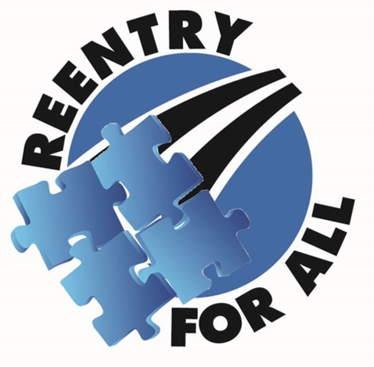
Kendra Jochum, LCSW-C
Reentry Services Manager
MCDOCR Detention Services Division
Kendra.Jochum@montgomerycountymd.gov
(240) 773-9982

